Slide 1

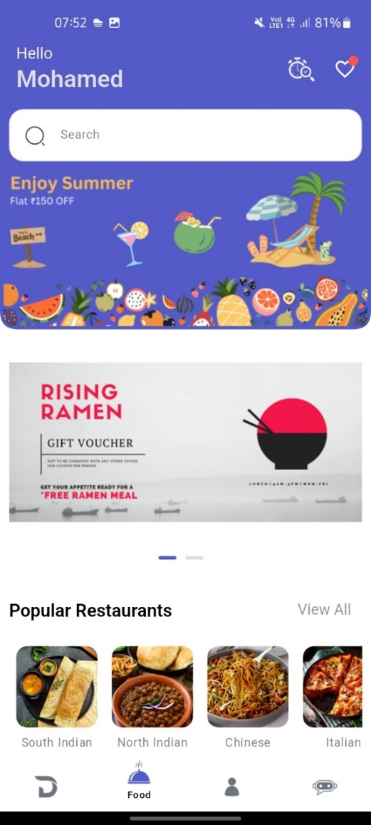
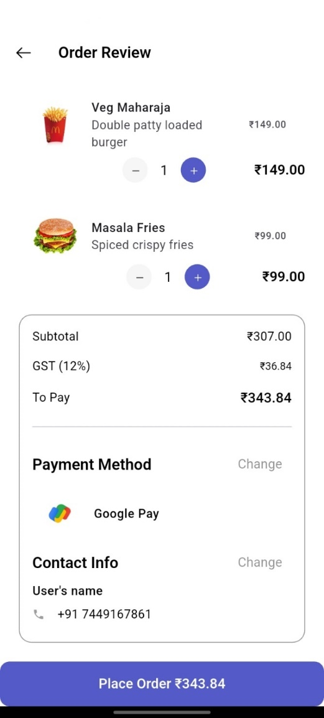
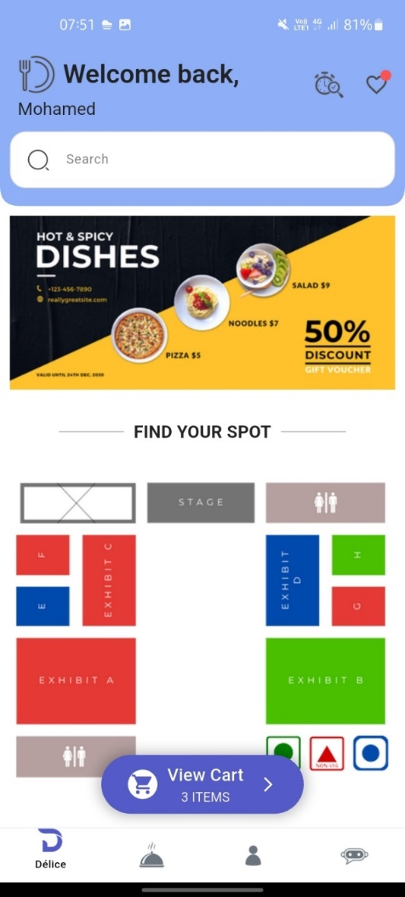
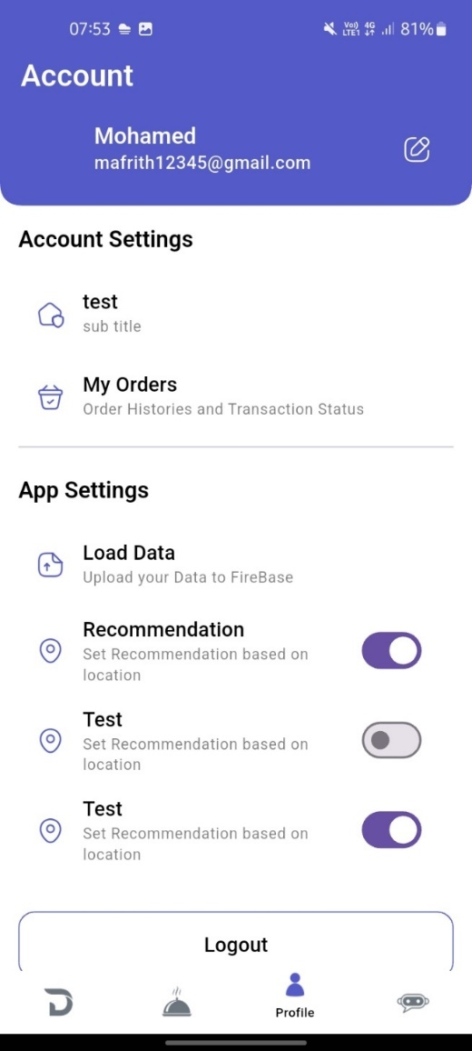

INTEGRATED FOOD COURT SERVICES PLATFORM
GUIDE: Dr. V. VIJILESH
MOHAMED IBRAHIM AFRITH M (23MCA035)
DEPARTMENT OF COMPUTER APPLICATIONS
ABSTRACT
BACKGROUND OF THE STUDY
RESULTS
DISCUSSION
Context: The mobile solution designed to bridge the gap between food court vendors and customers within a shared dining environment. It enables users to seamlessly browse restaurants, explore categorized menus, place orders, and manage their carts—all from their smartphones. Simultaneously, vendors can manage their listings, track orders, and update their offerings efficiently.
The implementation of the Integrated Food Court Management Application has significantly enhanced operational efficiency and user satisfaction, resulting in streamlined food ordering and increased vendor visibility. Supported by a strong backend infrastructure, the platform ensures smooth transactions and effective coordination between restaurants and customers. Overall, the system has delivered tangible benefits to both food vendors and consumers, laying the groundwork for future expansion within modern food court environments.
The discussion around the Integrated Food Court Management Application centers on its effectiveness in streamlining operations between customers and multiple food vendors within a centralized platform.
The app’s intuitive interface and feature-rich experience have received positive feedback from users, highlighting its success in simplifying food ordering, cart management, and vendor interactions.
By leveraging modern technologies like Flutter and Firebase, the platform ensures real-time responsiveness and scalability, making it a reliable solution for busy food courts.
Looking forward, continuous updates and feature enhancements—such as AI-driven food recommendations or advanced analytics for vendors—will be vital for maintaining user engagement and meeting the evolving needs of the food service industry.
The Integrated Food Court Management Application is a user-friendly mobile platform designed to seamlessly connect food court restaurants with customers. With distinct interfaces for users and vendors, the application simplifies food ordering, menu browsing, and transaction handling.
For customers, the app provides an intuitive way to explore restaurants, view categorized menus, and place orders directly from their smartphones. They can also interact with vendors and track their cart or order status in real time.
Vendors benefit from tools for efficient restaurant management, including product listing, category organization, and order processing with live updates. The app also supports analytics for sales tracking and performance improvement.
The system utilizes Flutter for cross-platform app development, Firebase Firestore for real-time cloud database, and Firebase Storage for handling media assets like food and restaurant images.
Overall, the application streamlines food court operations by enabling quick ordering and efficient vendor coordination, enhancing the digital dining experience within shared food court environments.
Significance: This application enhances the overall food court experience by reducing wait times, digitizing manual processes, and offering real-time interaction between customers and vendors. It streamlines ordering and improves service efficiency, promoting convenience, transparency, and operational growth for food vendors.
Identify Gap: Traditional food courts often lack centralized digital systems, leading to inefficient order handling, communication issues, and customer dissatisfaction. This application addresses that gap by offering a unified platform where vendors can digitally manage their restaurants and customers can enjoy quick, contactless service.
OUTCOME
The Integrated Food Court Management Application can be summed up in its ability to enhance convenience and efficiency for both restaurant vendors and customers. For vendors, it simplifies order management, menu updates, and provides real-time insights into sales and customer preferences, enabling smarter operational decisions. Customers benefit from a seamless browsing and ordering experience, allowing them to explore menus, place orders, and receive timely updates with ease. Overall, the application has made food court operations more streamlined, interactive, and user-friendly.
PROCESS/METHODOLOGY
User Research: Initial surveys and feedback sessions were conducted with both food court customers and vendors to identify pain points in the traditional ordering system. This helped shape the app features, such as intuitive browsing, real-time order tracking, and vendor management.
Frontend Development: The application was developed using Flutter, enabling cross-platform compatibility for both Android and iOS. Separate user interfaces were designed for customers and vendors to ensure a streamlined experience.
Backend Infrastructure: The app leverages Firebase services for backend support. Firebase Firestore handles real-time data management, Authentication secures user access, and Storage stores images like food items, logos, and banners.
Testing & Quality Assurance: Rigorous unit and integration testing was performed to validate each module including login, product browsing, cart updates, and order processing. This ensured smooth functionality and minimized runtime errors.
Continuous Enhancement: The system follows an iterative development approach. New features such as wishlist integration, search and filter, and vendor-side analytics are added based on ongoing feedback and usage patterns.
FUTURE ENHANCEMENTS:
In the future, the Integrated Food Court Management Application aims to expand its reach by introducing iOS support, ensuring a consistent experience across all major platforms. Enhancements such as AI-powered food recommendations based on user preferences and order history will personalize the dining experience. Additionally, a web-based version is planned to improve accessibility for both customers and vendors, promoting wider adoption and operational efficiency within food court environments.
ǪR LINK OF PROJECT VIDEO

